Slide 1
Traffic Fatalities
in San Francisco
What are the greatest factors that lead to fatalities?
By Jeremie Young

Slide 2
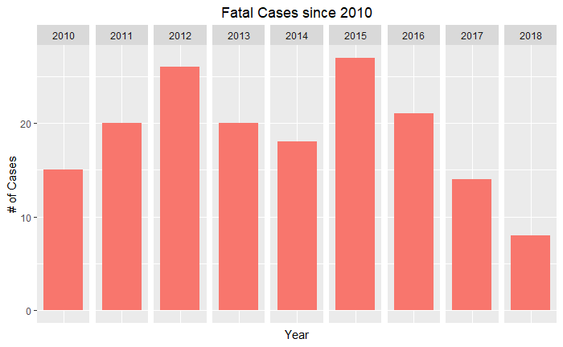
Background
In 2014, the late mayor Ed Lee and San Francisco politicians mandated the Vision Zero road safety policy that vowed to reduce traffic fatalities to 0 by 2024. The goal is traffic safety for the one million people who move about the City every day. However, at the end of 2018, the number of traffic deaths are at 23. This is 3 more deaths than 2017, moving the city further away from their goal.
Why it is important?
“Every year in San Francisco, about 30 people lose their lives and over 200 more are seriously injured while traveling on city streets.” (Vision Zero SF)
This chart only counts the number of cases (of known violations) that resulted in fatalities, not the count of actual fatalities.

Slide 3
Personal Motivations
I've grown up in San Francisco all my life. Observing how the city experienced a boom in tech, and in turn, a population boom, I see the latent consequences of such massive growth. The city was not intended to accommodate so many people. Issues include lack of affordable housing, widespread homelessness, and inadequate infrastructures. From a transportation standpoint, San Francisco is not the easiest to get around and is certainly not the safest.
I understand the risks associated with operating a vehicle and commuting as a pedestrian in a busy metropolitan city. While there are many perceived reasons for traffic incidents, I wanted to take a data-driven approach in recognizing key predictors of fatalities. Namely, which variables are the leading causes traffic fatalities?
Within this Intro to Data Science, I hope to lay a foundation in equipping myself with the tools to better answer the question over time. My long-term goal is to be part of the Zero Vision SF conversation in introducing data science as a viable tool to contribute in reducing traffic fatalities.

Slide 4
Data Scientist Approach
Gather a data set with all collisions in SF between 2010 to 2018
Determine possible predictors (independent variables) for the analysis
Clean the dataset
Summary Statistics
Binary Logistic Regression Model
Recommendations
Limitations

Slide 5
Goals of the Predictions
Predicting whether selected independent variables that are the leading causes traffic fatalities.
Iterate on the machine learning model to determine a suitable threshold value for such a small sample of fatal cases.
Use this project as the basis for further analysis to observe the collision severity variable to dive deeper, determining the most suitable independent variables.

Slide 6
Dataset
Dataset
Data is collected for each traffic incident on-the-scene by the California Highway Patrol. It is then recorded into a database called the Statewide Integrated Traffic Records System (SWITRS). The public is able to access records in accordance to The California Public Records Act (CPRA) (Gov. Code, § 6250 et seq.)
Contains 40,021 unique records
Noth non-fatal and fatal cases are included
2010 to 2017 was selected to ensure an adequate sample size - expansion since the last housing bubble in 2007 made the date range feel appropriate
Dataset named “Collisions”
Continued

Slide 7
Dependent Variable
Fatal - the binary categorical variable is defined by two levels, non-fatal or fatal. It indicates whether a fatality occurred in a given case. It is not, however, indicative of the number of deaths per case.
The variable was created from the existing “Collision Severity” variable in the data set.
Property Damage
Injury (Minor)
Injury (Moderate)
Injury (Severe)
Fatal
Non-Fatal
Fatal

Slide 8
Independent Variables
Across all independent variables, I predicted that collisions that have larger speed disparity between two objects resulted in fatalities, especially with pedestrians involved.
Primary Collision Factor or PCF Violation - the main violation as cited by the CHP officer
Driving or Bicycling Under the Influence
Impeding Traffic
Unsafe Speed
Following Too Closely
Wrong Side of Road
Improper Passing
Unsafe Lane Change
Improper Turning
Automobile Right of Way
Pedestrian Right of Way
Pedestrian Violation
Traffic Signals and Signs
Hazardous Parking
Lights
Brakes
Other Equipment
Other Hazardous Violation
Other Than Driver (or Pedestrian)
Unsafe Starting or Backing
Other Improper Driving
Pedestrian or Other Under the Influence
Fell Asleep
Continued

Slide 9
Independent Variables
Lighting - lighting conditions at the time of the incident
Intersection - whether the collision occurred in an intersection
Daylight
Dusk - Dawn
Dark - Street Lights
Dark - No Street Lights
Dark - Street Lights Not Functioning
No
Yes
Type of Collision - the manner in which the the vehicle struck either another car, person, object, etc.
Road Surface - road conditions at the time of the incident
Head-On
Sideswipe
Rear End
Broadside
Hit Object
Overturned
Vehicle/Pedestrian
Dry
Wet
Snowy or Icy
Slippery (Muddy, Oily, etc.)
Zip - 25 unique postal codes in the city
Continued

Slide 10
Data Wrangling
Starting Dataset
76 variables in dataset
Cross street values
Collision Severity
Independent variable values were either number or letter coded
Many insufficiently descriptive values
Too many variables, overloading model
Dataset for Modeling
Retained unique ID, modeling variables
Geocoded to uncover zip codes
Created binary “Fatal” dependent variable
Labels created to corresponding value using appendix
Filtered from the dataset
Removed perfect separation
The dataset used for modeling contained 8 variables
A total of 9973 records were removed from the dataset, 25% of the original amount
The tidyr and dplyr were used extensively

Slide 11
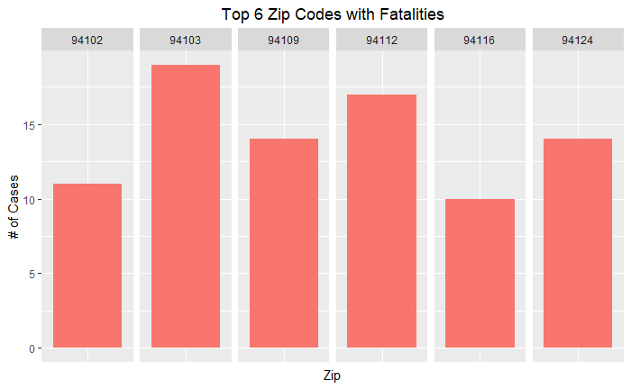
Summary Statistics on Fatal Cases
Upon examining the cleaned dataset,
I found that:
Non-fatal cases vastly outnumber fatal cases
The city is on track to reduce fatalities as of 2018*
There are at least 6 zip code areas that have at least 10 cases of fatalities out of the total of 25 unique codes in the city
Fatal Cases | 169
Non-Fatal Cases | 31191

Slide 12
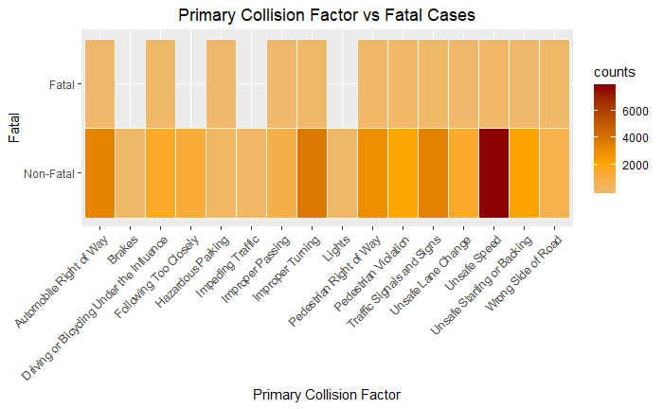
Fatal vs Independent Variables
To understand the visuals, frequency (count) is represented from least to most by the following color scale:
No count - blank
Low count - light yellow
Medium count - orange
High count - dark red
As shown in the following heatmaps, we see that fatal cases only represent a small number against the numerous non-fatal cases.

Slide 13
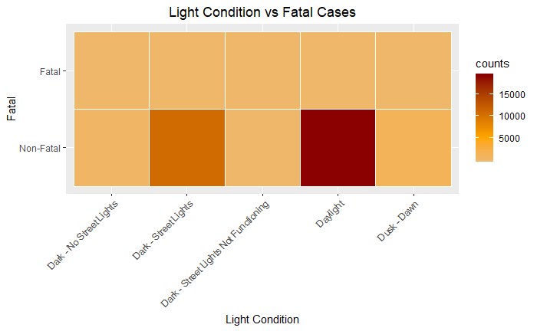
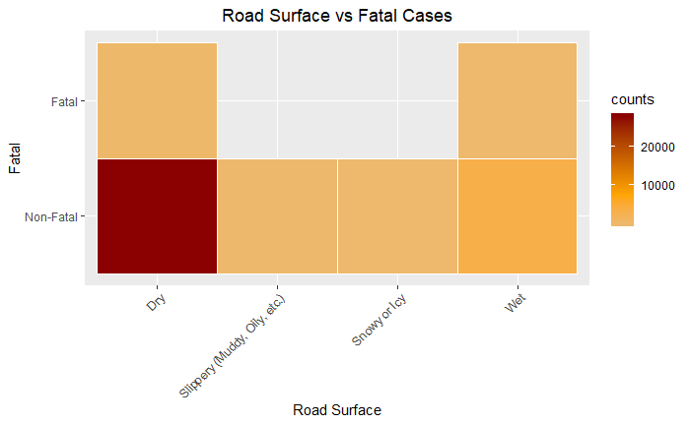
Fatal vs Independent Variables

Slide 14
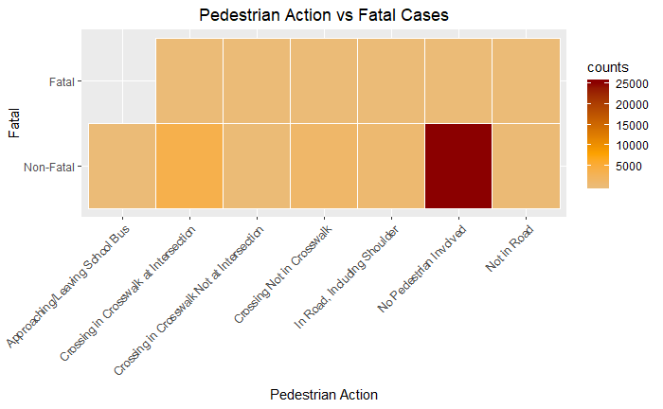
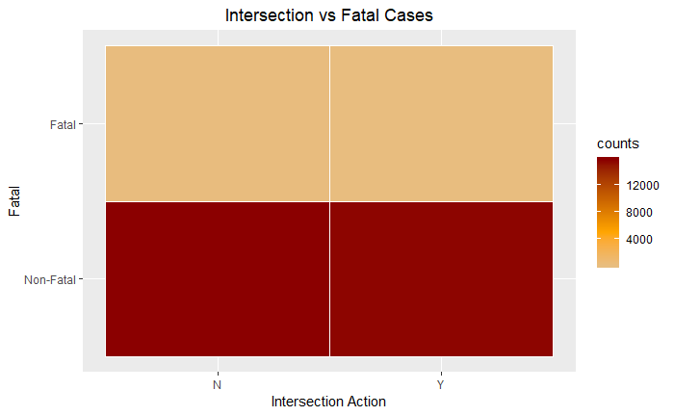
Fatal vs Independent Variables

Slide 15
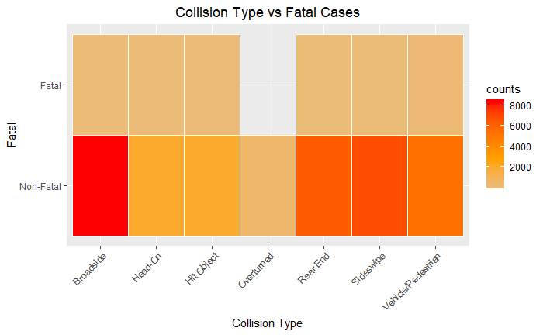
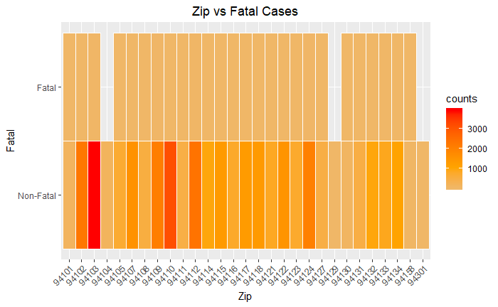
Fatal vs Independent Variables

Slide 16
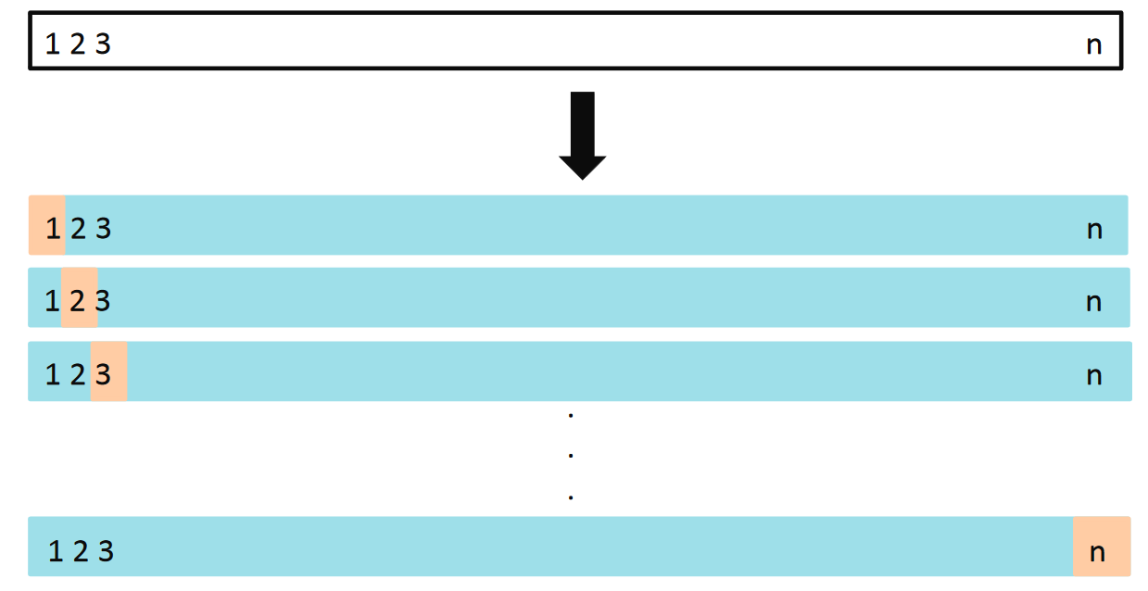
Binary Logistic Regression Model
A binary logistic regression model was chosen to predict the independent variables effect on “Fatal”.
Since the dataset contains so few fatal cases, the initial means of hold-out cross validation caused underfitting with the model. It was only when the threshold value was t = 0.1, where actual fatalities were predicted correctly. This meant that the model can fail to capture the underlying trend of the data.
To ensure a lower bias, I chose to use the
leave one out cross validation (LOOCV) method instead, making use of every data point. This method removes only one data point from the dataset, and trains the model on the rest of the data. This process iterates n times where
n = 30,048 (total # of unique data points).
How Good is Your Model? — Intro to Resampling Methods
(Marco Peixeiro, 2019)

Slide 17
Fitting of the Model
Threshold Value
The initial LOOCV run iterating on threshold values were set at seq(0.1, 0.9, 0.1), meaning from 0.1 to 0.9 by an increment of 0.1. The model only predicts any Fatal outcomes at t = 0.1.
Once it was determined that the general location of the threshold value t = 0.1, another pass was done at seq(.05, .15, .01). The first 10 passes resulted in NULL while the final pass at predicted Fatal outcomes at t = 0.15.
Confusion Matrix
The model accurately predicted 2 actual fatal and 29,864 non-fatal outcomes.
However, it incorrectly predicted 174 fatal outcomes as non-fatal. This is not a good model. A lower threshold value would be needed to make more accurate predictions.
 |  | Actual
 |  | Fatal | Non-Fatal
Predicted | Fatal | 2 | 8
 | Non-Fatal | 174 | 29,864

Slide 18
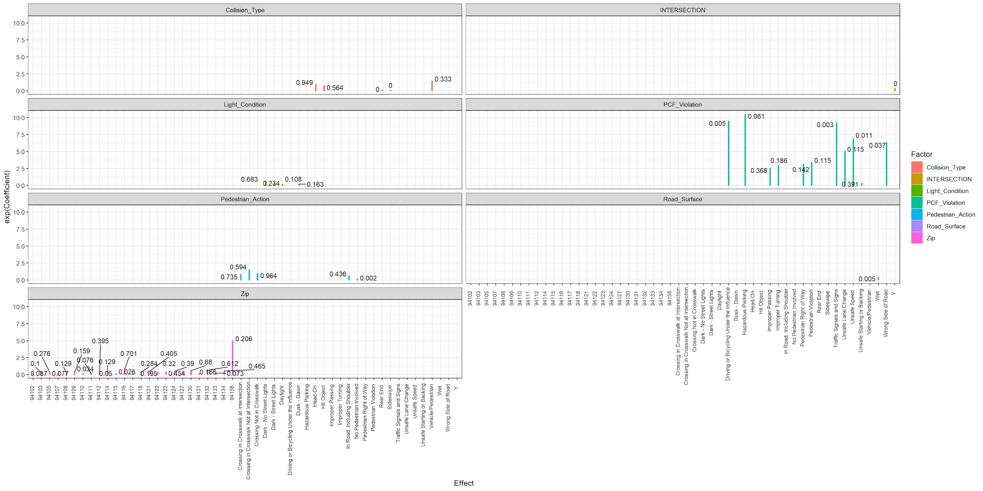
Coefficients
The coefficients are shown on a plot generated using ggplot2. The colored bars represent the coefficient estimates. As the length of the bar increases, odds of a fatal outcome increases.
The numbers above the bars represent the p-values. A smaller value is more statistical significance through a higher confidence level where (1-p)*100%

Slide 19
Results
Due to the nature LOOCV cross validation being time and processing intensive (at least 12 hours), no additional tests were done. A lower threshold value would have to be tested.
The model proved to be to very challenging at this stage of learning data science. However, it did show information that makes sense. The most useful independent variable in determining fatal outcomes is Primary Collision Factor (PCF).
The specific outcomes that increase the odds of fatalities are:
Driving or Bicycling Under the Influence (99.5% confidence level)
Hazardous Parking (93.9%)
Traffic Signals and Signs (99.7%)
Unsafe Speed (98.9%)
Wrong Side of Road (96.3%)
The results do acknowledge my predictions on speed disparity between collision objects as influential to fatalities. Though the lack of pedestrian specific predictors are concerning considering that fatal collisions involving pedestrians typically outnumber bicycle and car only collisions year over year. (City & County of SF, City Performance Scorecards)

Slide 20
Recommendations
Driving or Bicycling Under the Influence should always be scrutinized by local government and law enforcement. Steps should always be taken to reduce reckless behavior around alcohol.
Parking restriction signs should be made clear to reduce incidents from Hazardous Parking in areas where vehicles are at speed.
San Francisco can be a very distracting and busy place to drive. Traffic Signals and Signs should be very simple and clear to drivers so that they can adjust their driving accordingly.
Unsafe Speed kills. Reduced limits, law enforcement, or speed limiters like roundabouts, speed bumps, speed traps can mitigate more high speed collisions.
Paint in dividers where vehicles can easily go on the Wrong Side of the Road. Narrow roads in SF are a given but having clear indicator of two-way traffic can help.

Slide 21
Limitations
“The number of annual fatalities is subject to year-to-year fluctuations and a high degree of random variation, limiting the ability to draw statistically meaningful trends on an annual basis.” (City & County of San Francisco, City Performance Scorecards)
Lack of Zip code data. Cross streets data to extract zip codes using a mapping API tool geocod.io. With the accuracy scores between 0 and 1 for each record, I needed to manually cross reference geocoded zip codes with the provided cross streets.
The omission of speed at which the incident occurred. As reported by the National Highway Traffic Safety Administration, “speeding has been involved in approximately one-third of all motor vehicle fatalities.” (NHTSA) The absence of such an important determining factor is a significant limitation.
Removal of “Unknown”, “Not Stated”, and any other insufficiently descriptive values. They accounted for 20% of the original dataset. This meant that for fatal cases that contained any those values, were removed from the dataset.
The models had to be cleared from perfect separation. This is a common condition that occurs when the data set is too small to observe events with low probabilities. The more predictors are in the model, the more likely separation is to occur because the individual groups in the data have smaller sample sizes.
The use of a LOOCV cross validation method was extremely time consuming to determine a proper threshold value. It took upwards to half a day.
The consolidation of the “Collision_Severity” variable to “Fatal” is a huge limiting factor in the sense that important features are lost as a result, oversimplifying a complex problem. Traffic fatalities only make up a small part of the overall collision problem that can help us, in turn, better understand fatalities. This project can be expanded upon using a multinomial logistic regression model.

Slide 22
End

